Slide 1



sale insight using Power BI
View in Power BI
Last data refresh:
7/12/2022 9:08:06 AM UTC
Downloaded at:
10/2/2022 5:10:14 PM UTC

Slide 2
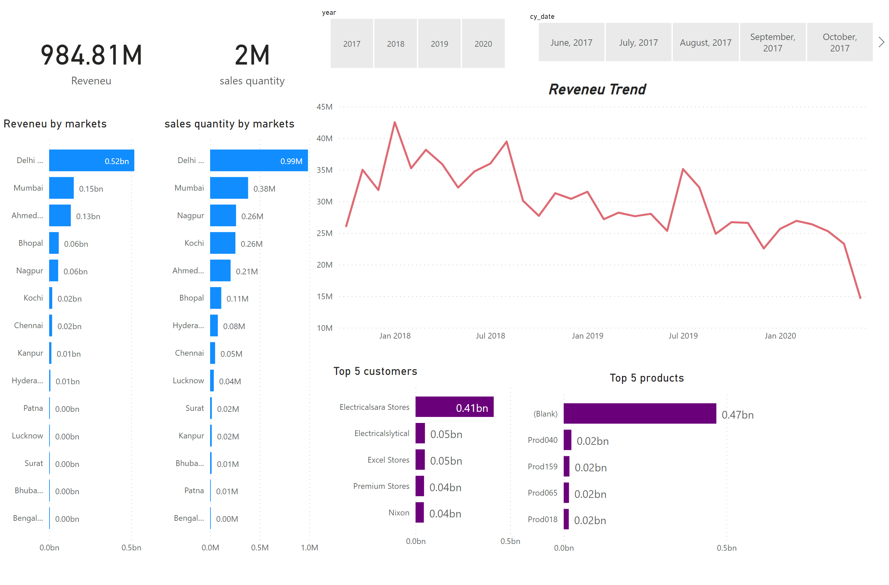
Page 1
Notes:
card
No alt text provided
card
No alt text provided
slicer
No alt text provided
Reveneu by markets
No alt text provided
slicer
No alt text provided
sales quantity by markets
No alt text provided
Top 5 customers
No alt text provided
Top 5 products
No alt text provided
Reveneu Trend
No alt text provided

